Slide 1
Academic Affair Committee Ethiopian Student Association, IITR Useful Locations and Links on First Arrival
July 2023

Slide 2
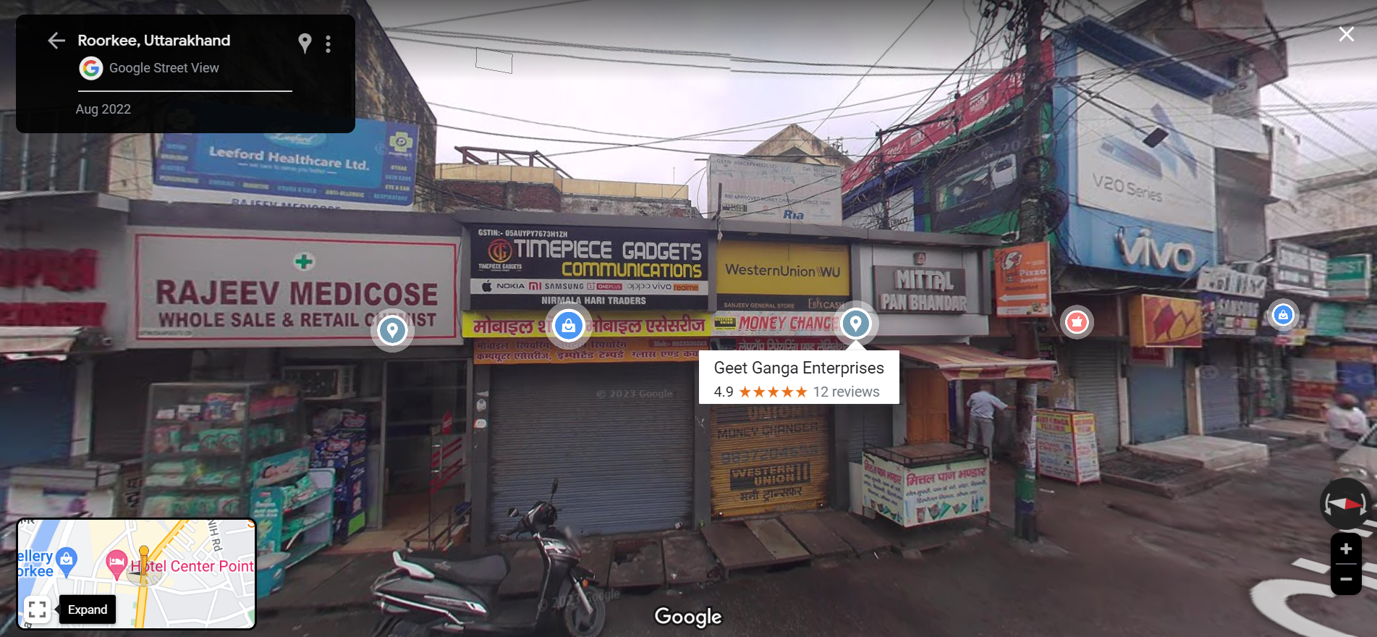
Foreign Currency Exchange Location
The first useful place on the first arrival is the Foreign Currency exchange store,
There are few foreign exchange stores near to Himgiri apartment
in front of
Century gate

Slide 3
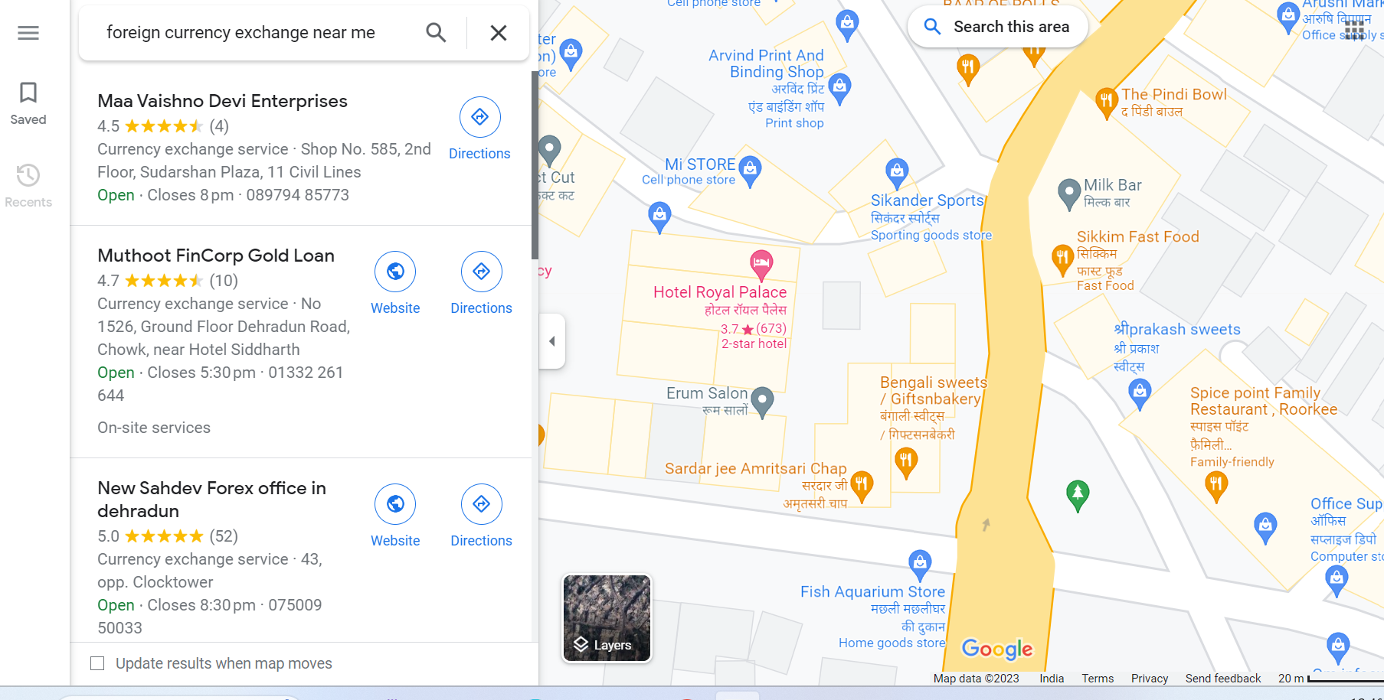
Foreign Currency Exchange Location
The first useful place on the first arrival is the Foreign Currency exchange store,
There are few foreign exchange stores near to Himgiri apartment
in front of
Century gate
https://goo.gl/maps/hDtgZrNZ7ardHnmw7

Slide 4
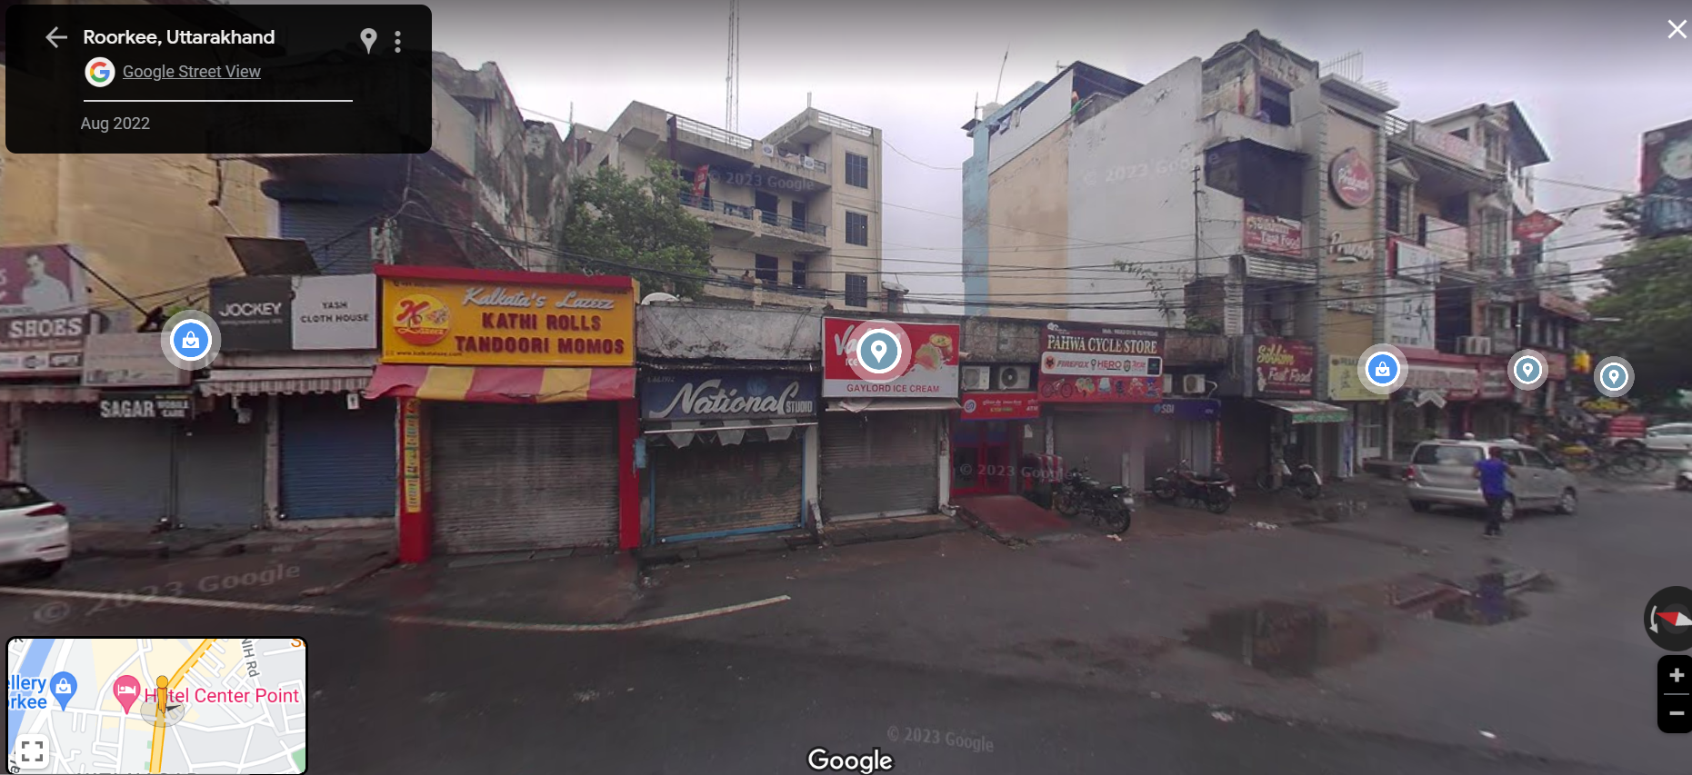
Shopping Locations
TASK CLOTH HOUSE FOR MATTRESS AND RELATED ITEMS
Location in front of
Century gate
https://goo.gl/maps/hDtgZrNZ7ardHnmw7

Slide 5
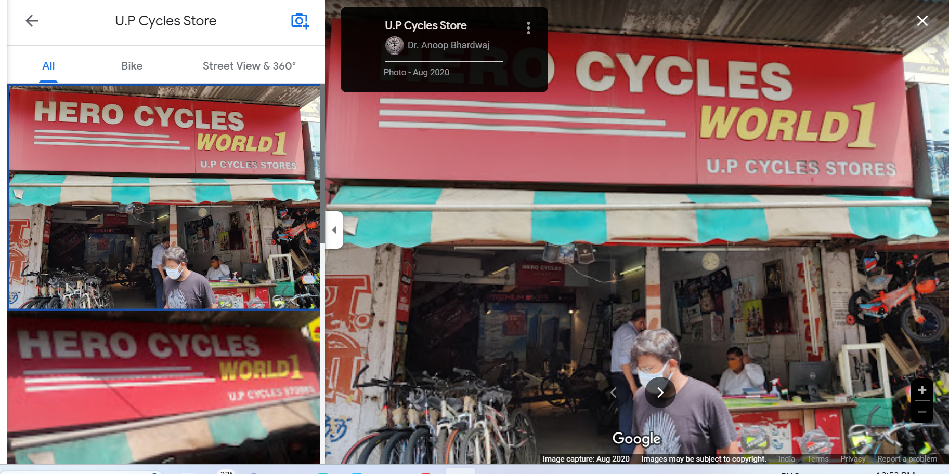
Shopping Locations
Store locations for buying Cycle and Kitchen Items
Location in front of
Century gate
, toward Airtel
shop
https://goo.gl/maps/xcCb311K3v9dB94w6

Slide 6
Shopping Locations
Store locations for buying Cycle and Kitchen Items
Location in front of
Century gate
, toward Airtel
shop
In front of this
Location you can
Bed sheet and
other kitchen materials shops find
https://goo.gl/maps/xcCb311K3v9dB94w6

Slide 7
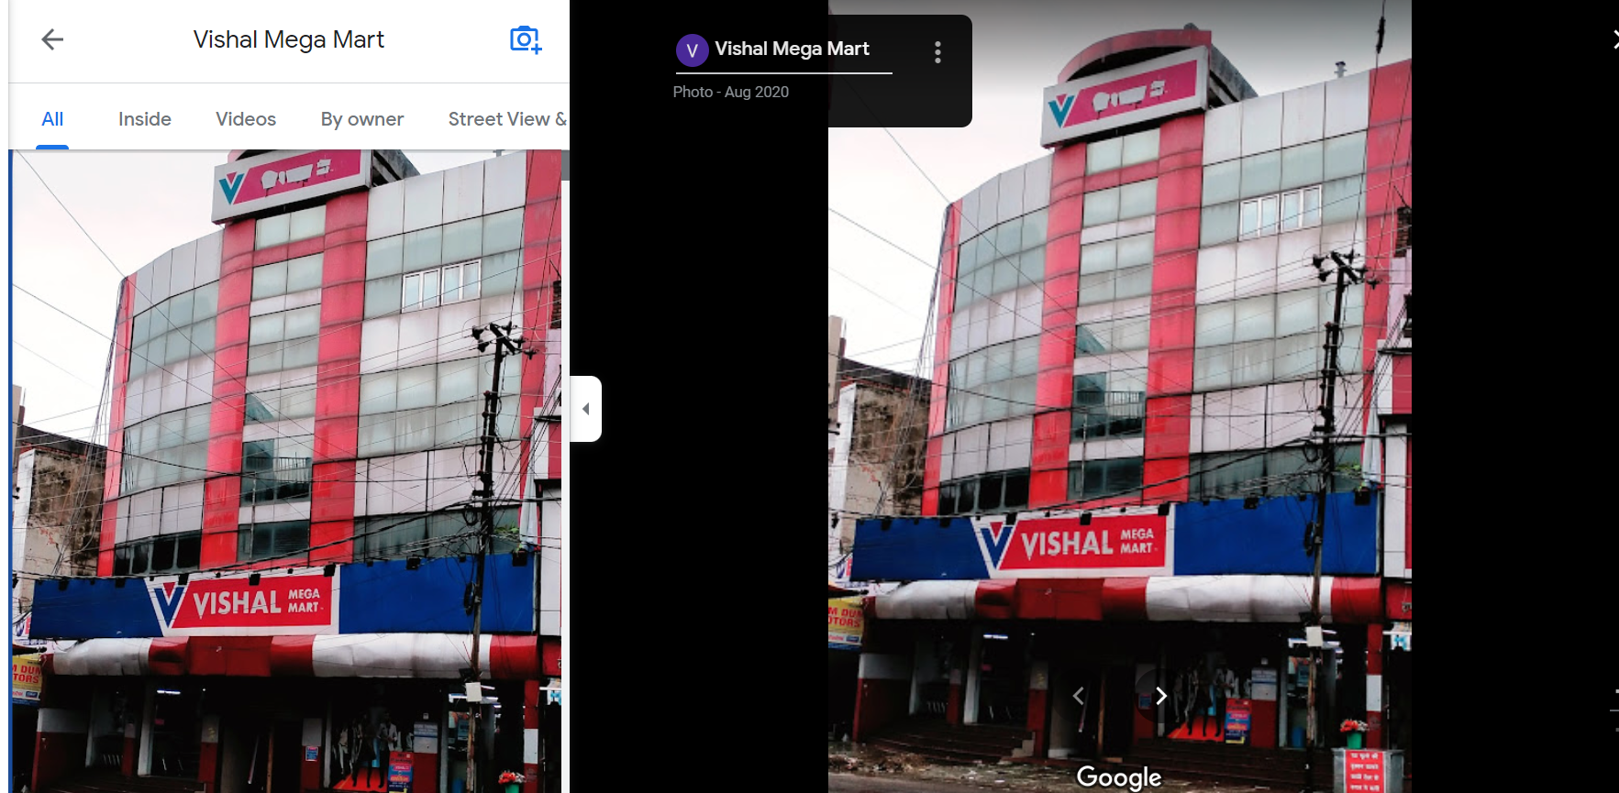
Shopping Locations
Vishal Mall- All items with low price
You need to use a rickshaw or cycle toward the left of the century gate from the Himgiri Location.
Good for kitchen
materials
https://goo.gl/maps/GNPvwFp1cFTGjmY68

Slide 8
Thanks…

